Slide 1

AEMR EXECUTIVE PRESENTATION
MEHMET TIRAS 09/2020

Slide 2
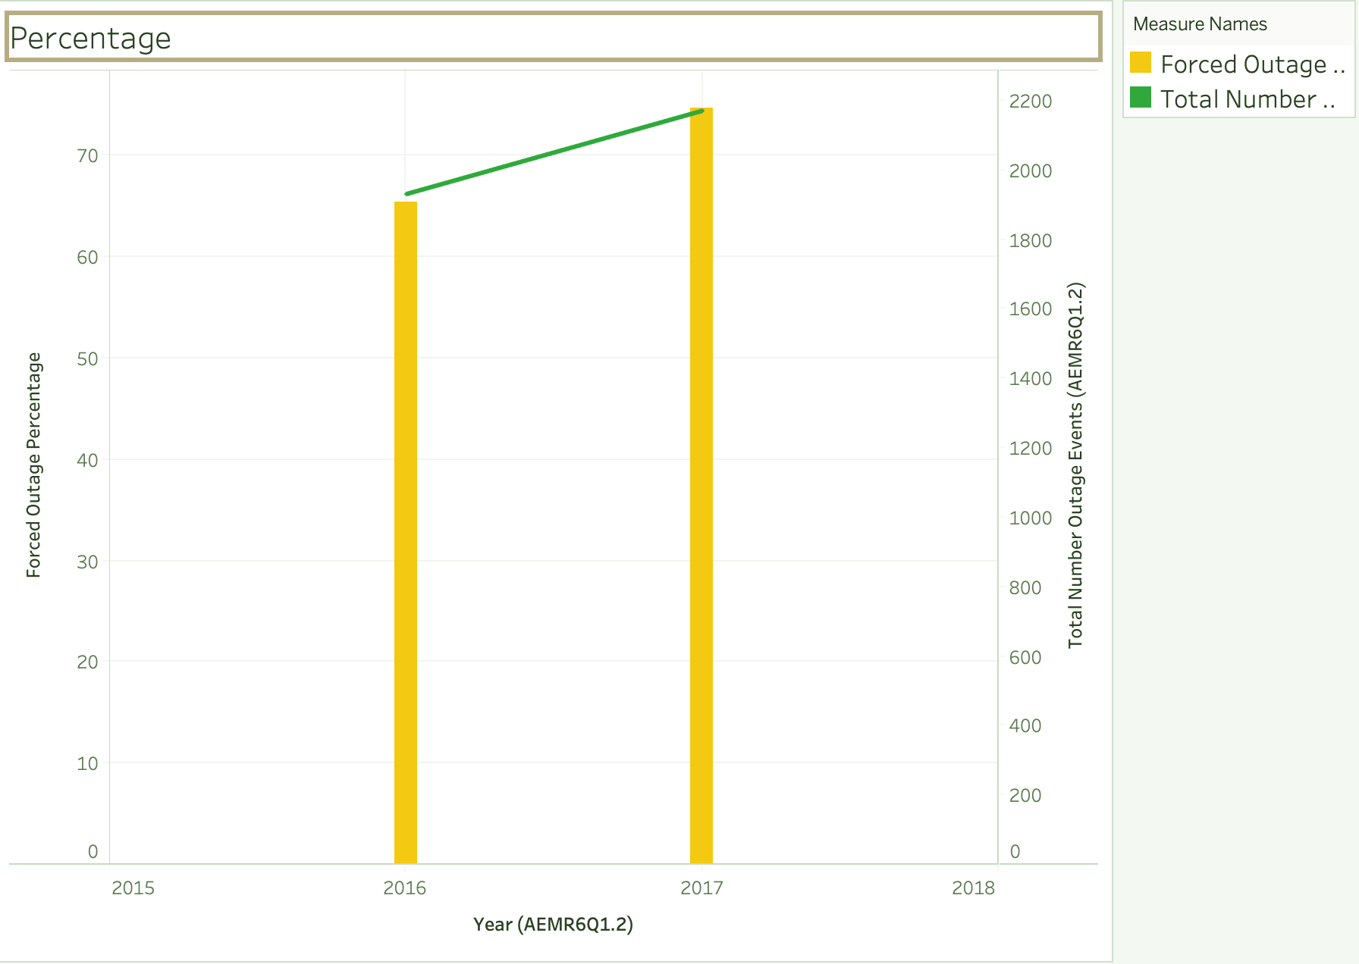
AEMR will face heavy risk chains if it cannot take precautions for some supply companies in the upcoming period. Total Forced Outages arise ~10% between 2016 and 2017.
2016 Total Number Outages Events
1931
2017 Total Number Outages Events
2171
Total Forced Outage Percentage Arise from 65.5% in 2016 to 75% in 2017
Total Number Outage Events: All service companies give an outage 1931 events totally in 2016 and 2171 in 2017
Total Number Forced Outage Events: 1264 in 2016 and 1622 in 2017
Total Number Consequential Events: 181 in 2016 and 127 in 2017
Total Number Opportunistic Maintenance(Planned) Events: 106 in 2016 and 102 in 2017
Total Number Scheduled (Planned) Events: 380 in 2017 and 320 in 2017
Average Outage MW Loss: 312 in 2016 and 272 in 2017

Slide 3
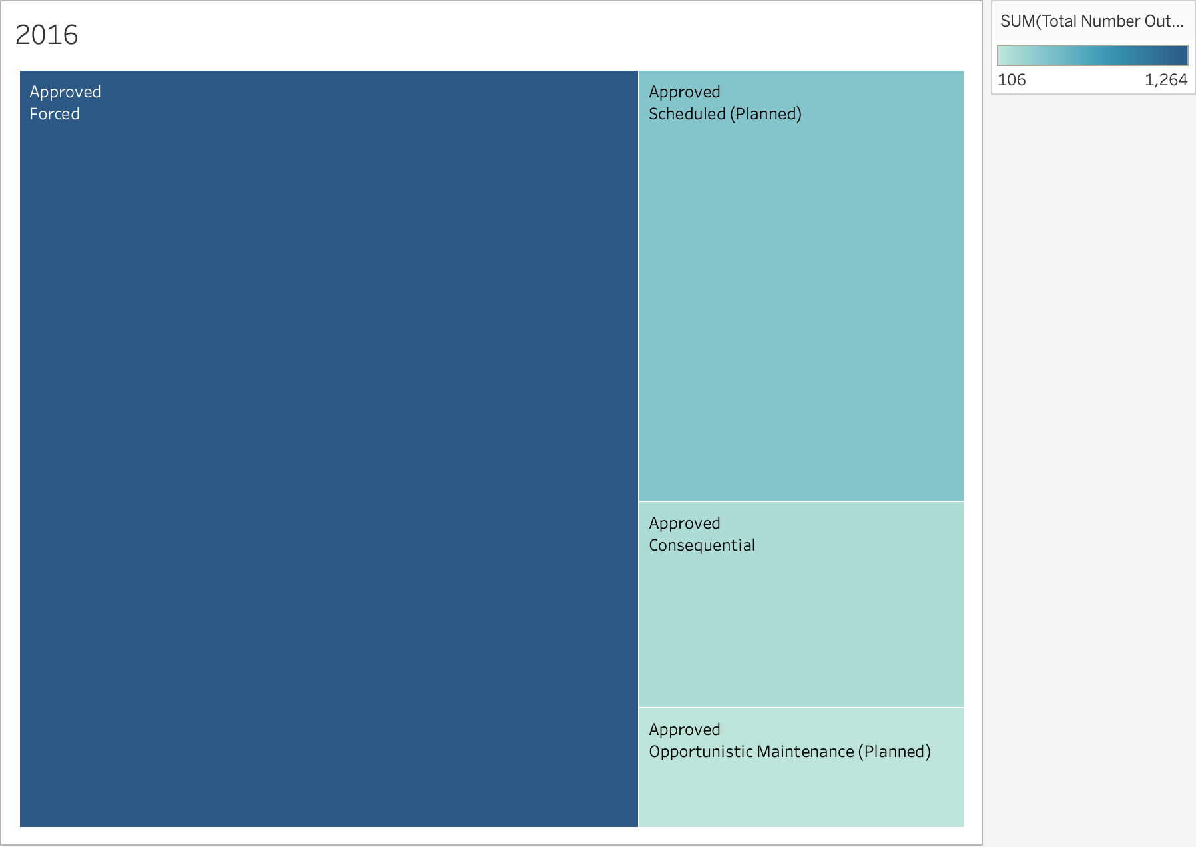
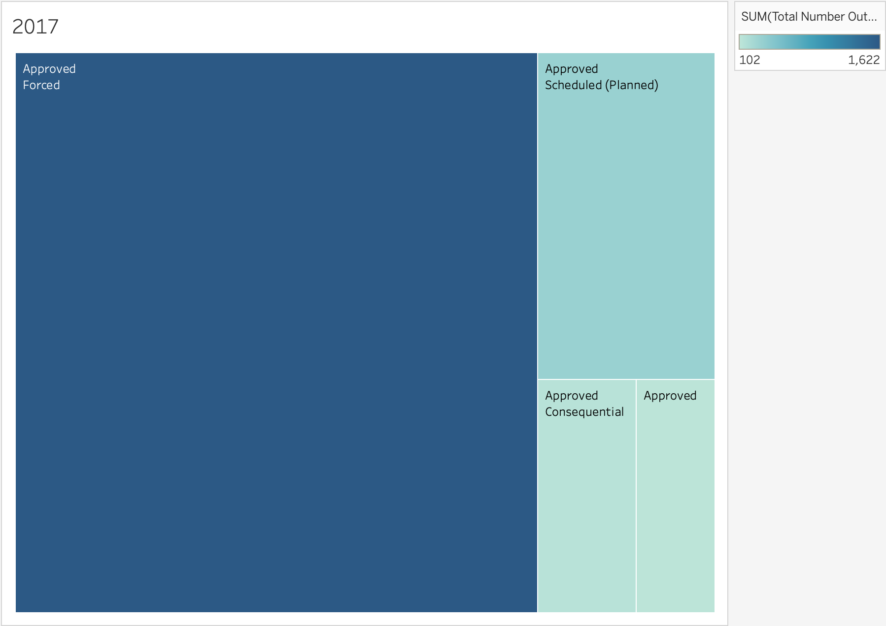
Either in 2016 or in 2017 Forced Outages cover expanse area comparing to the others

Slide 4
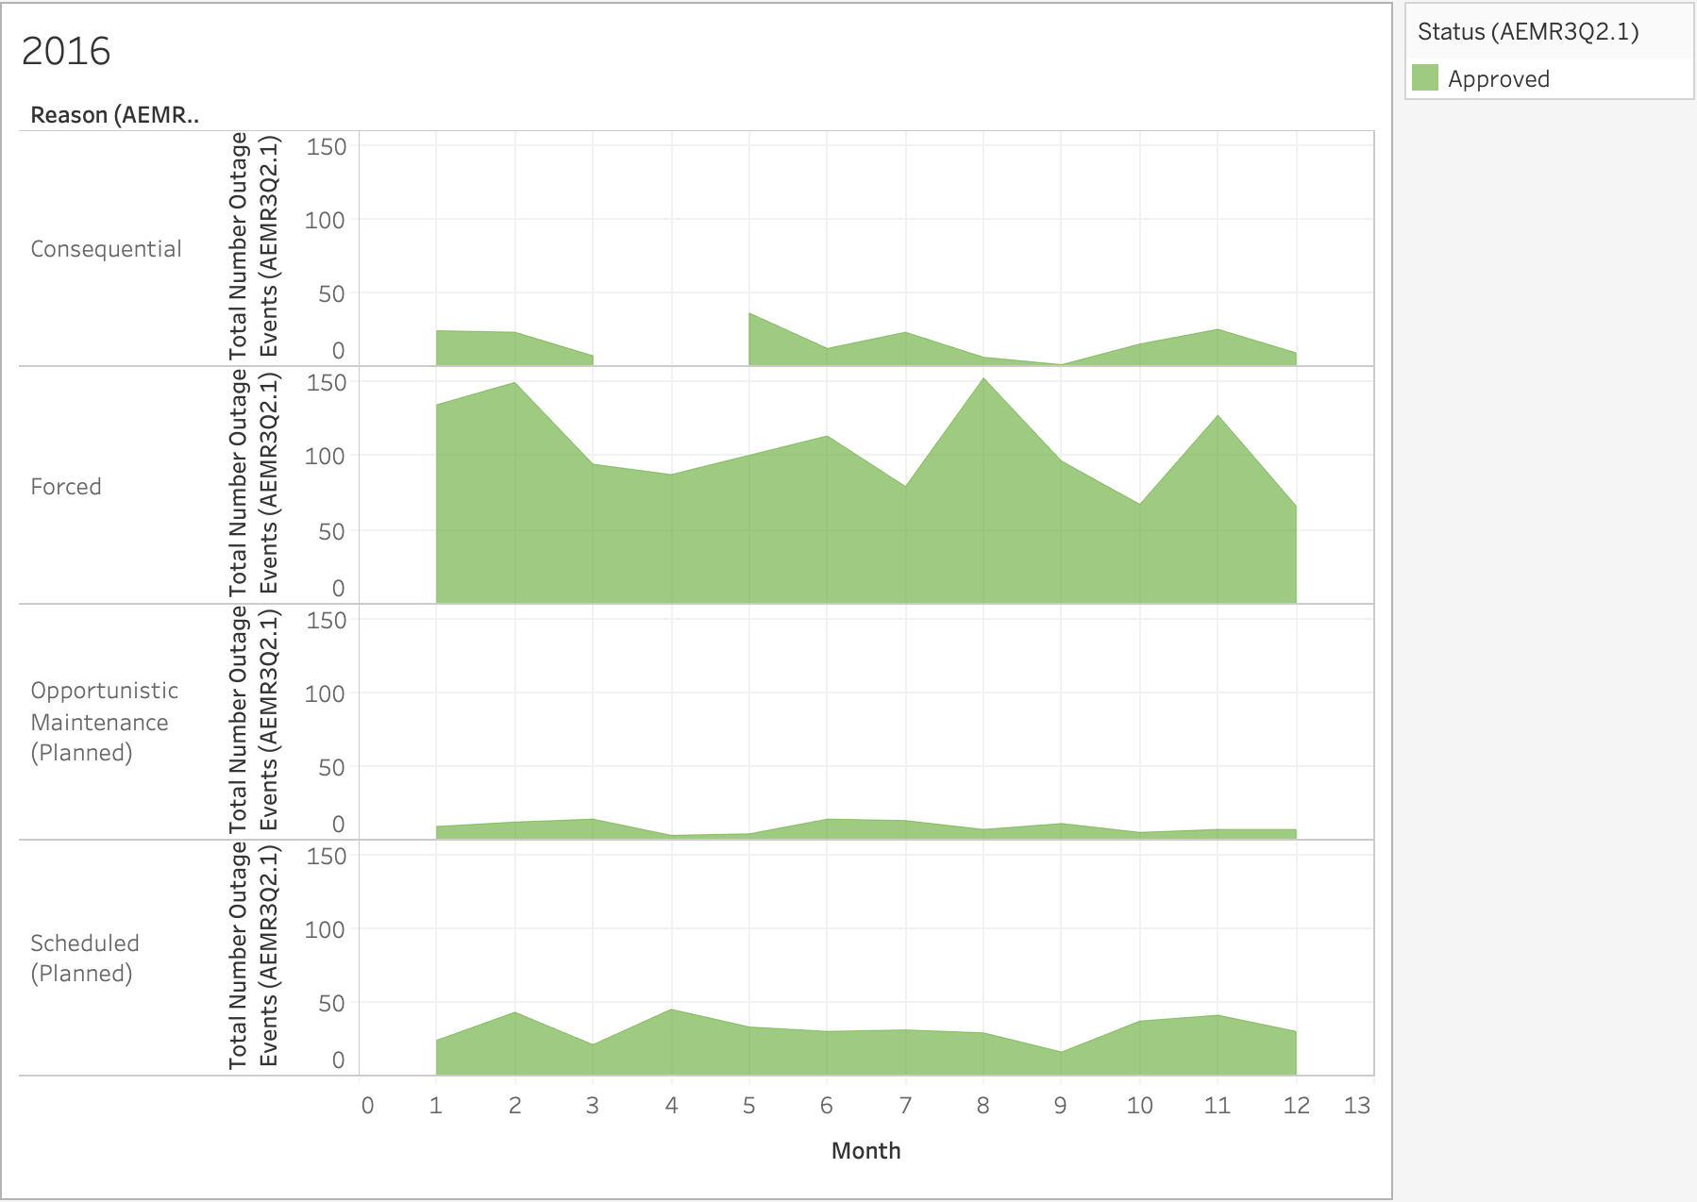
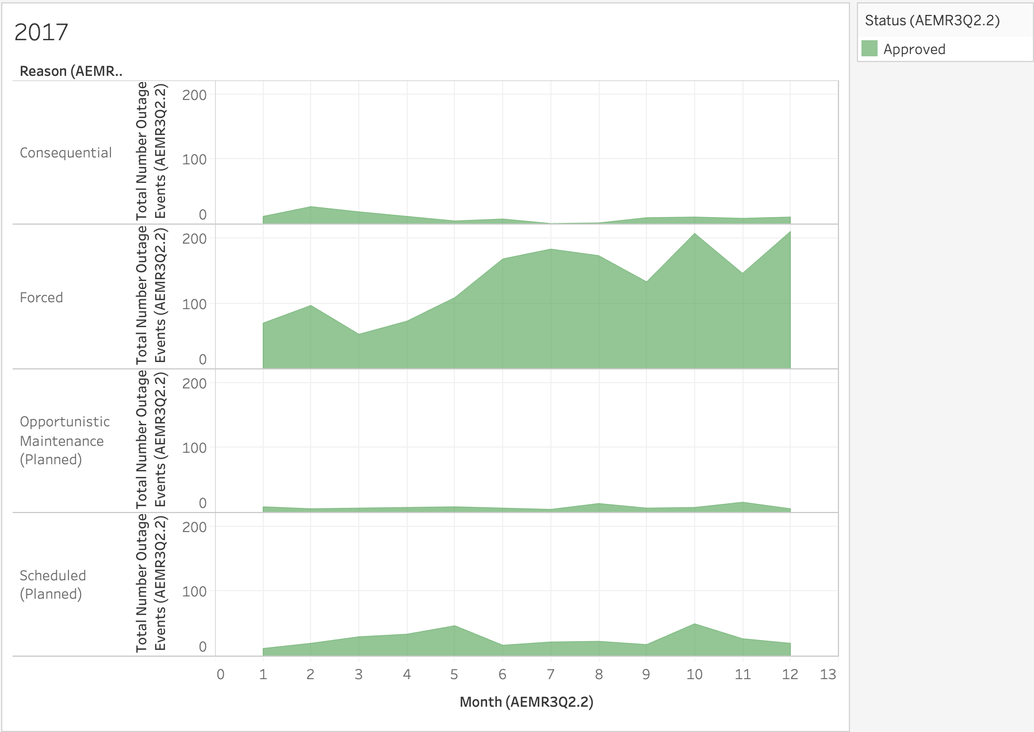
Tableau charts illustrate monthly outages changes in between 2016 and 2017.

Slide 5
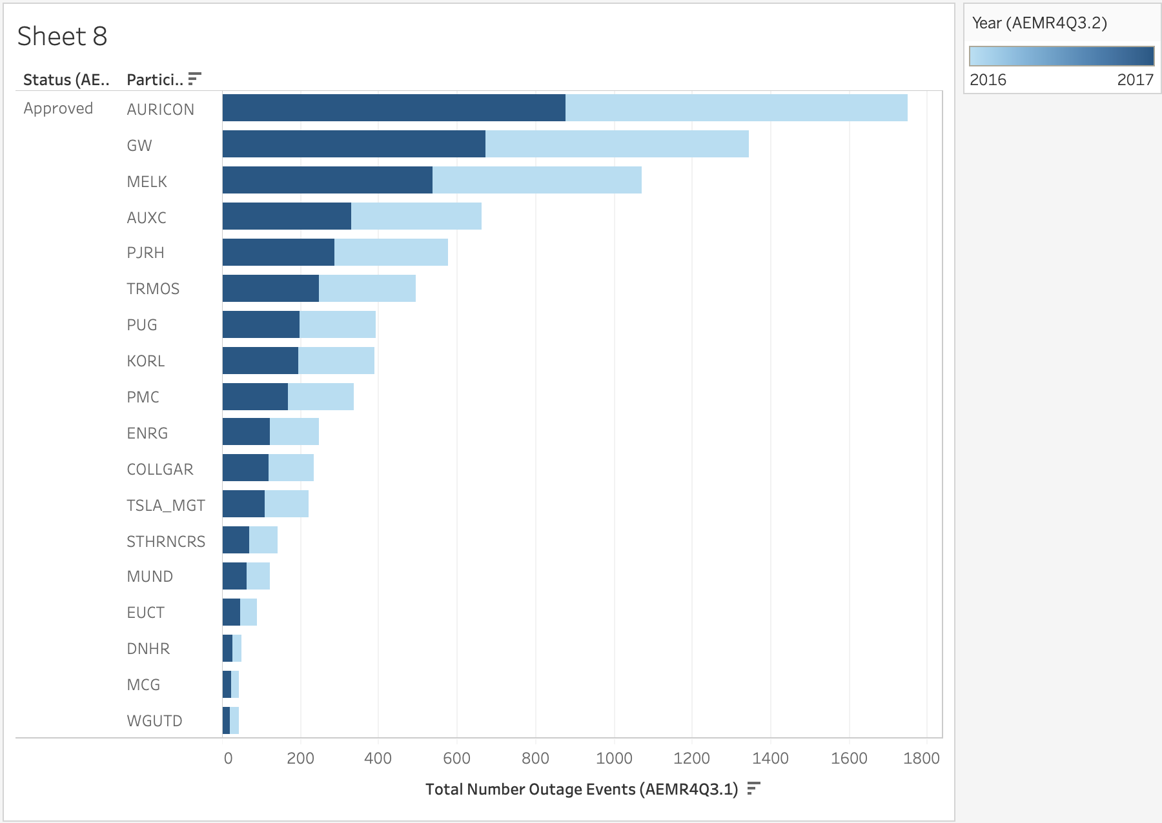
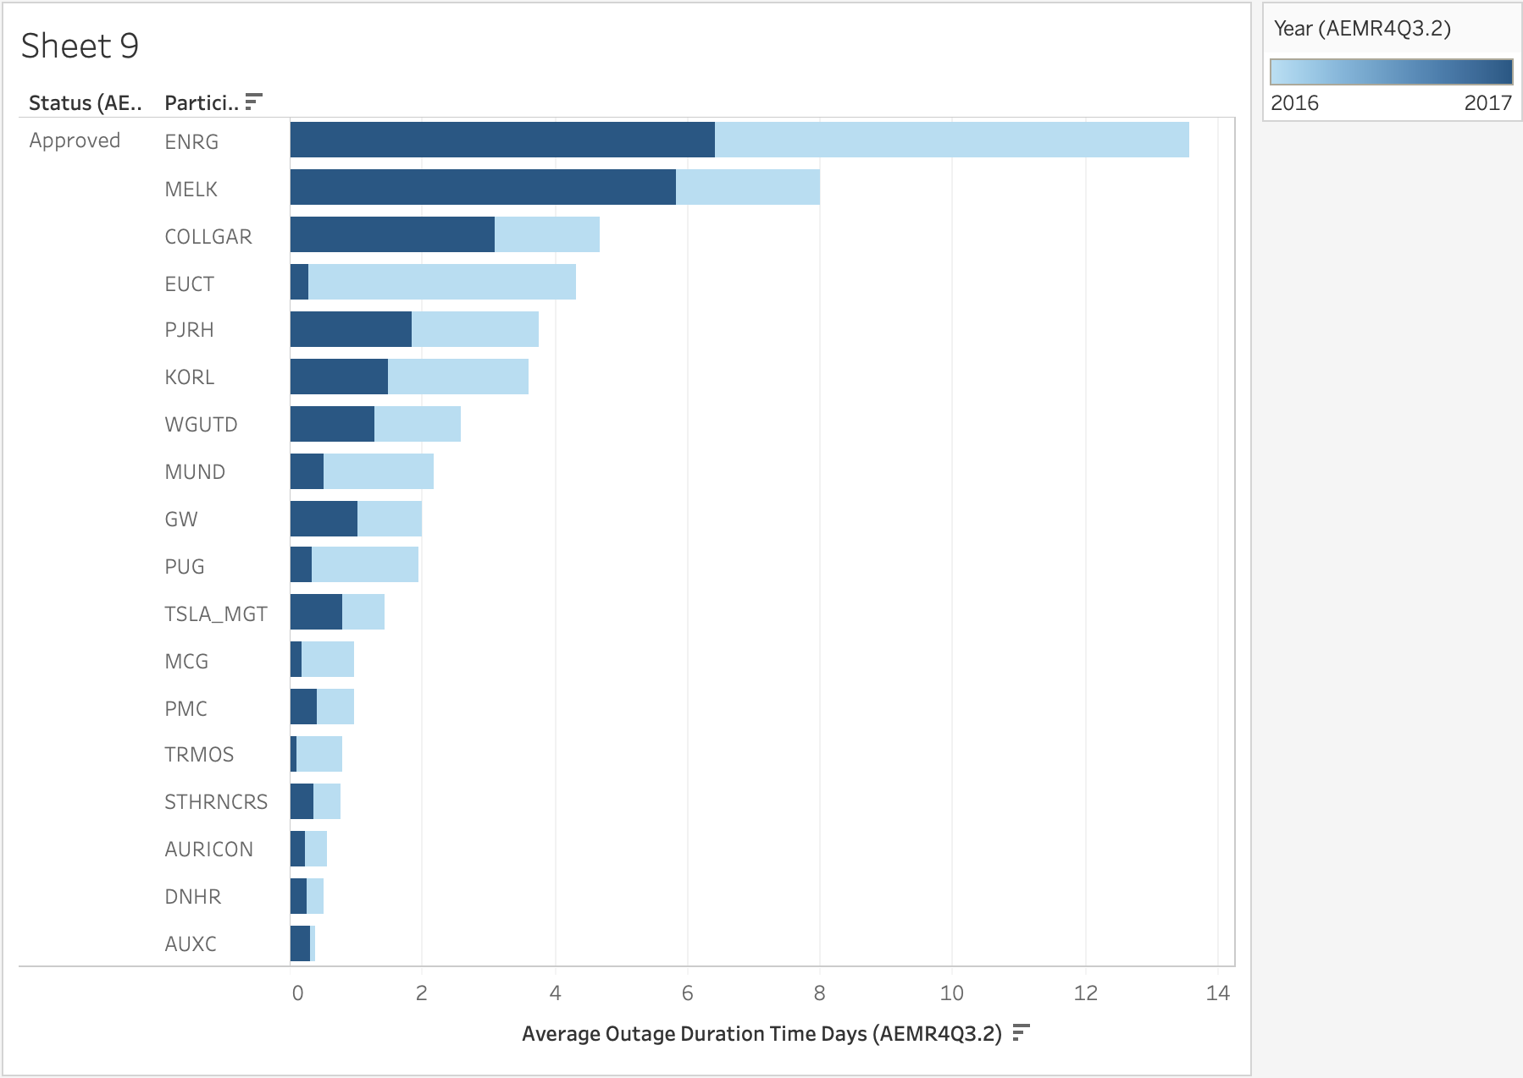
Here are listed companies by the total number of outage events and average outage duration time as daily.

Slide 6
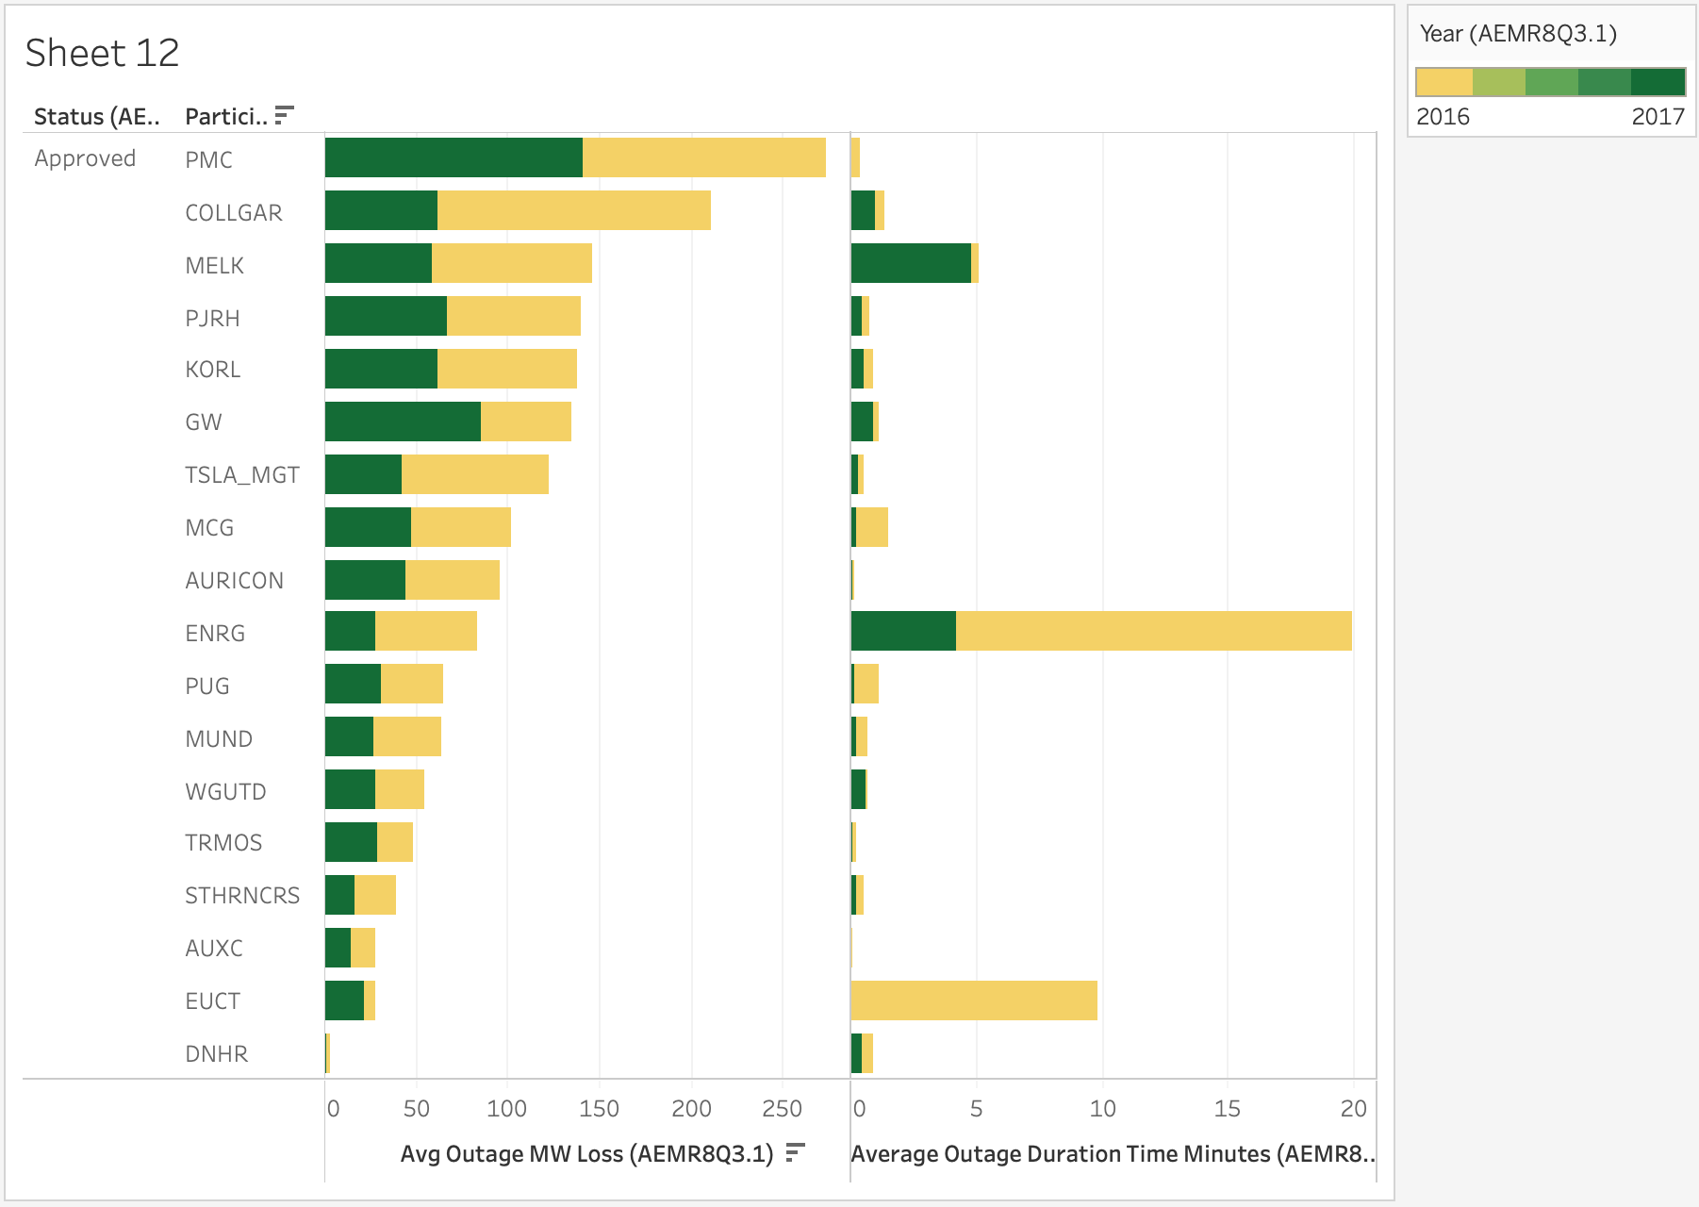
The average outage of MW loss and average outage of duration time of minute in this chart in 2016 and 2017.

